Slide 1
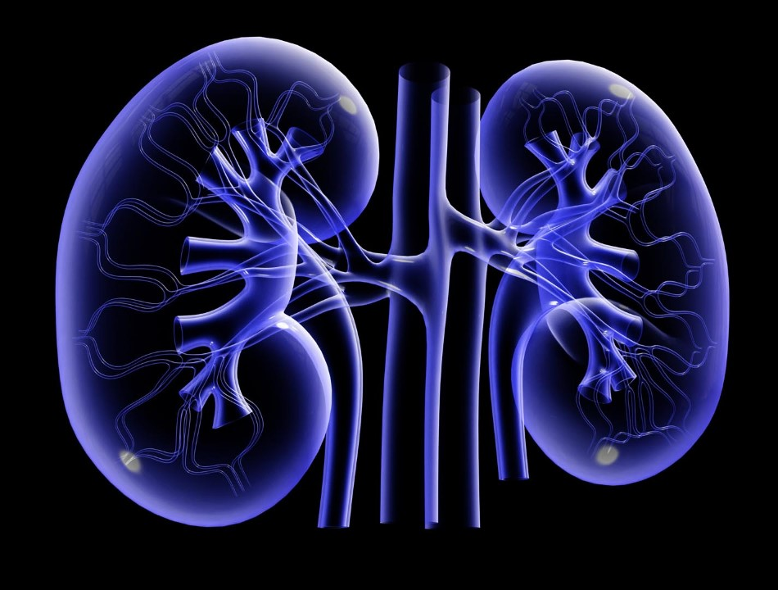
Von Hippel-Lindau Disease
Alex Waldman

Slide 2
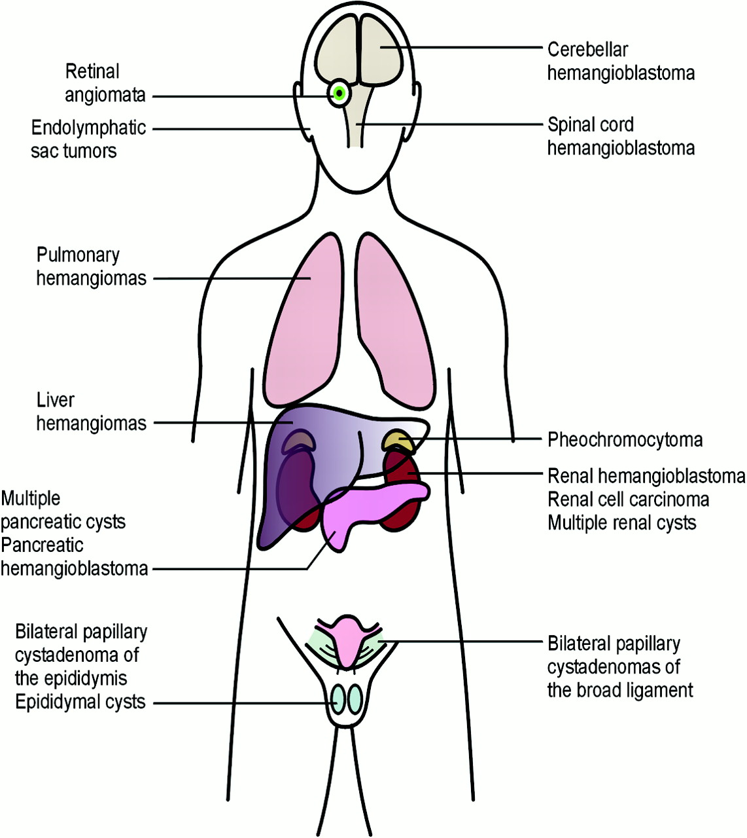
What is Von Hippel Lindau Disease?
Notes:
Affects 1/36,000 VHL is a autodom disorder on chromosome 3 that is characterized by tumors and cysts that grow throughout the body. Hemangioblastomas, a specific kind of tumor, can form on brain, retinas and spinal cord while cysts may develop pancreas and kidneys [1]. Although most of these tumors are benign, they require close monitoring to prevent spreading to other organs. The leading cause of death for these patients in renal cell carcinoma.

Slide 3
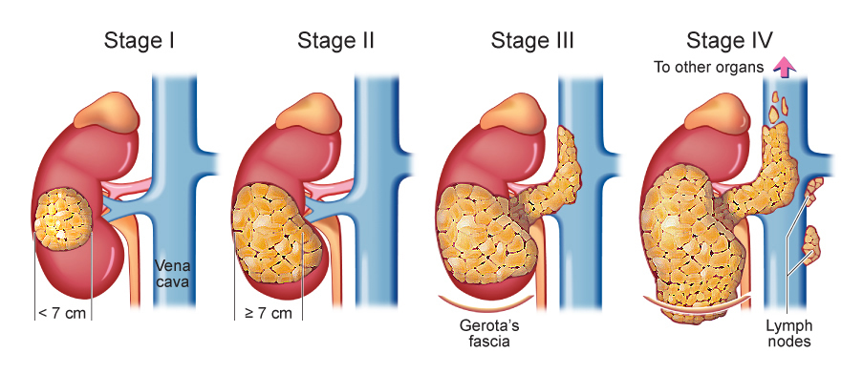
What is Renal Cell Carcinoma?
Notes:
RCC is the most common form of kidney cancer in adults. It is when malignant cells form in the tubules of the kidney.
Symptoms of RCC are blood in urine, lump in abdomen, loss of appetite and weight loss. Asymptomic until it has progressed into later stages.

Slide 4
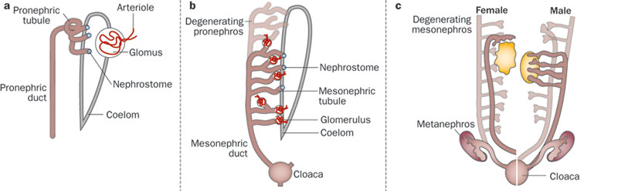
How do kidneys develop?
Metanephros
Mesonephros
Pronephros
Notes:
Pronephros is earlist nephric stage in kidney develop. In humans, it is present for the first 4 weeks then it degrades. While this is occuring, the mesonephros kidney begins to form. (4—8 weeks). It gradually degenerates, although parts of its duct system become associated with the male reproductive organs. Metanephros than form, which is the excretory system we have.
More primitive organisms have a pronephros excretory system.
In general, most fish and amphibians have mesonephros kidneys. Metanephros is reptiles, birds and mammals.
Each organism has different levels of degradation of the previous nephros system.

Slide 5
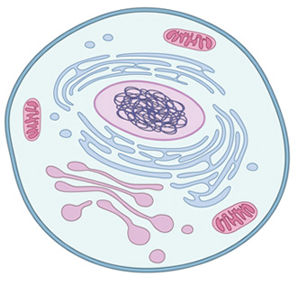
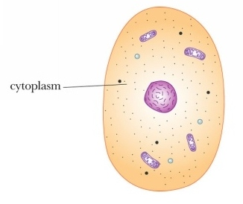
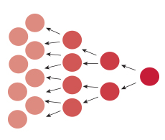
What gene is mutated in VHL patients?
VHL1!
0
Low complexity
VHL beta domain
VHL box domain
213
144
57
149
204
10
63
Cellular Component
Molecular Function
Biological Process
Cytoplasm
Notes:
VHL1! VHL is a tumor supressor. The gene is made up of two protein domains.
VHL beta domain: beta sheet
VHL box domain: alpha helical has been found to help with bind specificity of some proteins that bind to the beta domain
Cellular component: VHL is almost exclusively found in the cytoplasm.
Molecular function: tumor supressor, E3 ubiquitin ligase and protein binding
Biological Process: cell morphogenesis, cell differentiation and transcriptionIt negatively regulates cell proliferation and apoptosis

Slide 6
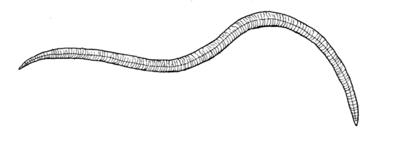
How well is VHL conserved in other organisms?
Low complexity
VHL beta domain
VHL box domain
93%
81%
78%
70%
65%
54%
32%
28%
Notes:
VHL is highly conserved across organisms. Zebrafish is 54%. Also interesting the it is more in C. elegans than drosphila.

Slide 7
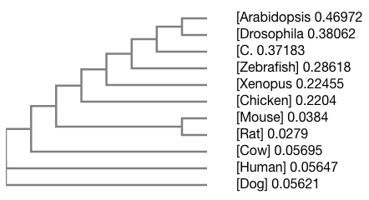
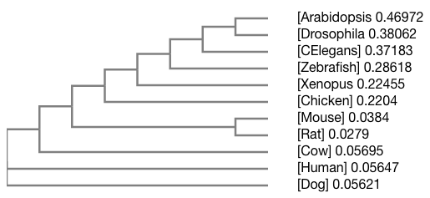
What is the relationship of VHL across these homologs?
Metanephros
Mesonephros
Pronephros
Notes:
See grouping

Slide 8
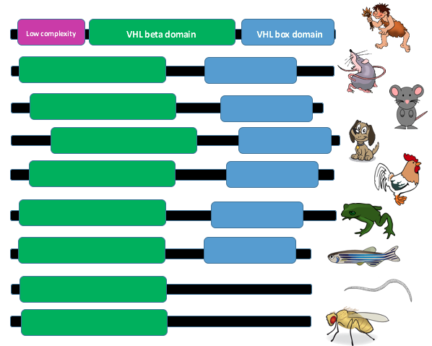
Why did I choose zebrafish?
Mesonephros
Notes:
I choose zebrafish as my model organism because they have mesonephros excretory system. It is the first form of a more complex excretory system. In addition, mesonephros excretory organisms are the first group that had the VHL box domain.
Zebrafish are a great model organism for kidneys because it is easy to visualize tumor and cyst formation. The image here shows a wildtype vs. mutant zebrafish that has a clear kidney cyst indicated by the arrow and it has body curvature.

Slide 9
GAP: What is the role of VHL in kidney development?
Notes:
Add question mark

Slide 10
What is the primary goal?
Determine is the role of VHL in kidney development
B
A
VHL
C
E
Aim 1
Aim 2
Aim 3
Identify conserved amino acids in VHL and use CRISPR
Identify a small molecule that restores function in VHL mutant zebrafish
Identify novel VHL protein interactions important for kidney development

Slide 11
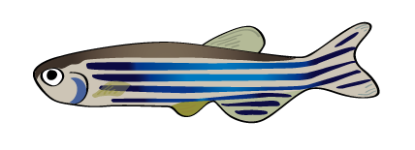
Aim 1: How will I identify conserved amino acids?
VHL box domain
VHL box domain
Zebrafish
Xenopus
Mouse
Rat
Human
C. Elegans
Drosophila
Notes:
To identify conserved amino acids in the VHL box domain, I used Clustal Omega and Jalview. I wanted to identify amino acids that were conserved across all organisms with mesonephros and metanephros systems while not in pronephros or uncharacterized because I believe this amino acids must play a key role in kidney development. The arrow indicate where this occurs.

Slide 12
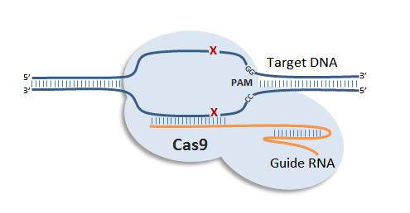
Aim 1: How will I use CRISPR to create mutant VHL zebrafish?
Notes:
Now that I have identified these amino acids in meso and meta systems, I will use CRISPR to change the amino acid in zebrafish to the amino acid that drosophila had at each of these places. After doing this, I would allow the zebrafish to develop to confirm they obtained the phenotype.
Rationale: Since the VHL box domain is not found in pronephros, the conserved aa must be important for kidney formation.

Slide 13
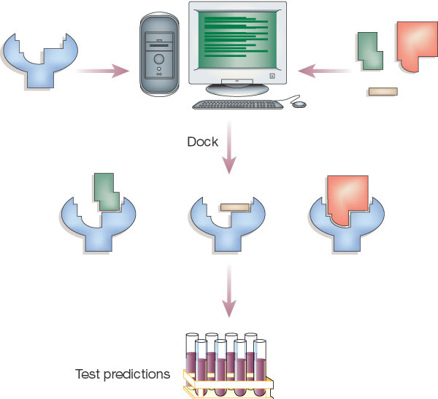
Aim 2: How will I create a diversity-oriented library?
DOCK
Compile a DOS
VHL
Compile a DOL
Chemical Screen
Notes:
To find a small molecule I need to compile my DOL. To do this, I will run the structure of VHL and potential small molecules through a virtual screen using the program DOCK. This will provide me with molecules that have a better chance of binding to VHL.

Slide 14
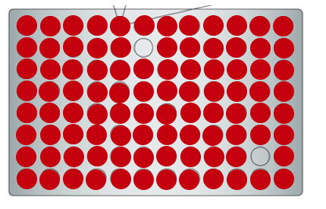
Aim 2: How will I set up my chemical screen?
Diversity-oriented library
Diversity-oriented library
Notes:
I would than take my DOL and array it onto a multi-well plate. I harvest the kidneys of WT and VHL mutant zebrafish and array them. Then I would observed the rate of cell proliferation. I would identify this by comparing the rate of cell division in my VHL mutant zebrafish to the normal rate of my WT. In the future, I would like to take the small molecule into a clinical trail with rats because they have 93% identity.
Could just rescue cell proliferation
Take kidney tumor cells and see if stop dividing
Cell division and apoptosis know which will be enriched

Slide 15
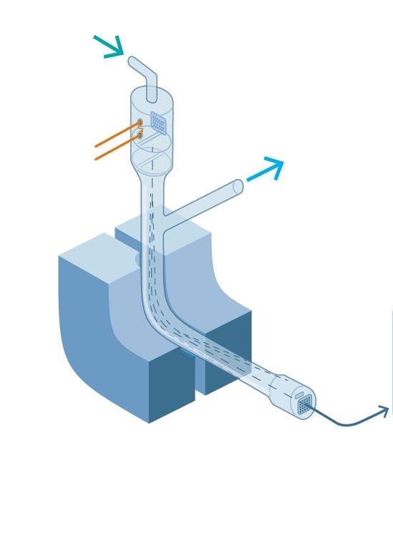
Aim 3: How will I isolate novel proteins interacting with VHL?
B
LC-MS
VHL
+
A
E
C
D
B
A
A
VHL
VHL
D
C
E
E
Notes:
For Aim 3: I want to identify novel protein interactions that are specifically important for in the kidneys. To do this, I will run a TAP Tag assay on WT and mutant. I would expect to find some proteins that only interact in the WT, which would show that protein interaction could be important.

Slide 16
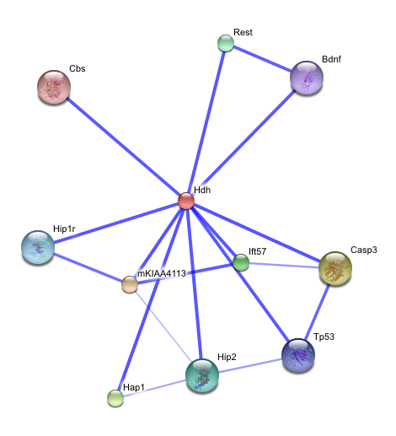
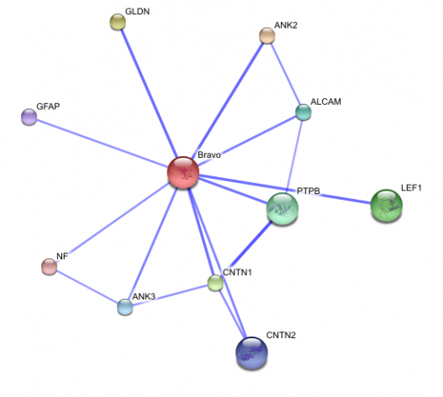
Aim 3: What will I do with these novel proteins?
Cell Proliferation
Apoptosis
Notes:
I would than use gene ontology to sort these proteins based on cell proliferation and kidney localization. My rationale is that I would find the protein interactions that are kidney specific since VHL is found all over the body.

Slide 17
Future Directions?
VHL
Notes:
Look into rats
RNAseq to observe what is upregulated and downregulated in mutant and WT mice to investigate its function as a transcription

Slide 18
References
Used throughout
Zebrafish http://4.bp.blogspot.com/-qHe9PH1Z3Pc/UY0TJT4zRmI/AAAAAAAAAHc/kOzSdbPbHbg/s1600/zebrafish.png
Normal kidney: https://www.consumerhealthdigest.com/wp-content/uploads/2015/02/kidney-cancer.jpg
Disease kidney: https://www.consumerhealthdigest.com/wp-content/uploads/2015/02/kidney-cancer.jpg
Human: http://www.okclipart.com/Human-Clip-Art30uuwsszvs/
Mouse: http://www.clipartkid.com/cartoon-mouse-cliparts/
Rat: http://clipart-library.com/clipart/8iGEdqArT.htm
Xenopus: http://clipart-library.com/clipart/di9Kdbn5T.htm
Fly: https://upload.wikimedia.org/wikipedia/commons/thumb/6/6e/Drosophila-drawing.svg/2000px-Drosophila-drawing.svg.png
Red dividing cells image: https://www.thermofisher.com/blog/wp-content/uploads/sites/9/2016/12/sho-cell-proliferation-s007844.jpg
Cell right: https://www.nature.com/scitable/content/ne0000/ne0000/ne0000/ne0000/14704902/U1CP1-5_ProkvsEukCell_ksm.jpg
Skull: https://d30y9cdsu7xlg0.cloudfront.net/png/9626-200.png
Computer: http://www.nature.com/nature/journal/v432/n7019/images/nature03197-f2.2.jpg
VHL bound to small molecule: http://www.nature.com/nature/journal/v432/n7019/images/nature03197-f2.2.jpg
Used once
Slide 1.
http://www.thekidneydiseasesolutions.com/thekidneydiseasesolutionreview/
Slide 2.
https://s-media-cache-ak0.pinimg.com/originals/ec/96/d2/ec96d291df7788bcc25c8746a9776135.jpg
Slide 3.
http://www.newhealthadvisor.com/images/1HT00981/Cell-Carcinoma-sydney.jpg
Slide 4.
Kidney development: http://www.nature.com/nrneph/journal/v9/n3/images/nrneph.2012.290-f1.jpg

Slide 19
More References
Slide 5.
Cell left: https://ajweinmann.files.wordpress.com/2010/02/cytoplasm.jpg
E3: https://upload.wikimedia.org/wikipedia/commons/thumb/5/5b/Ubiquitylation.svg/300px-Ubiquitylation.svg.png
Protein-Protein interaction: http://2.bp.blogspot.com/-KSrWsi9Ev4k/Uj3gUQ4NhSI/AAAAAAAAAzg/MJr6czwUgJM/s1600/Intera%C3%A7%C3%A3o+entre+prote%C3%ADnas.png
Slide 6.
C. elegans: http://www.fastonline.org/CD3WD_40/CD3WD/HEALTH/H2115E/GIF/P140A.GIF
Chicken: http://www.clipartkid.com/images/73/rooster-cartoon-04-cartoon-animals-bird-chicken-rooster-cartoon-04-e7kg9p-clipart.png
Slide 7.
Tree: http://www.ebi.ac.uk/Tools/msa/clustalo/
Slide 8.
Zebrafish image right: http://dev.biologists.org/content/131/16/4085.figures-only
Slide 9.
Question marks: https://s-media-cache-ak0.pinimg.com/originals/6e/00/0e/6e000ec02c7c93eef58146bcb1c63682.jpg
Slide 12.
CRISPR: http://www.creative-animodel.com/images/CRISPR-Cas9.jpg
Slide 13.
Virtual screening image: http://www.nature.com/nature/journal/v432/n7019/images/nature03197-f2.2.jpg
Slide 14.
Normal and mutant kidney cells: http://www.nature.com/nrneph/journal/v11/n7/images/nrneph.2015.82-f5.jpg
Slide 15.
TAP Tag: http://www.nature.com/nrm/journal/v4/n1/images/nrm1007-f1.jpg
LS-MS: http://hiq.linde-gas.com/internet.lg.hiq.global/en/images/S_20151020_54564_2527899_177177.jpg?v=1.0
Slide 16.
Gene Ontology: https://s3.amazonaws.com/go-public/image/go-logo.large.png
STRING left: http://maricquegen677s09.weebly.com/uploads/1/7/2/1/1721465/1551695.png?527x472
STRING right: http://nickelsgen677s09.weebly.com/uploads/1/7/2/1/1721478/9009566_orig.png?83x90
Slide 17.
Heat map: http://www.sthda.com/sthda/RDoc/figure/genomics/rna-seq-differential-expression-workflow-using-deseq2-beginner_geneHeatmap.png

Slide 20
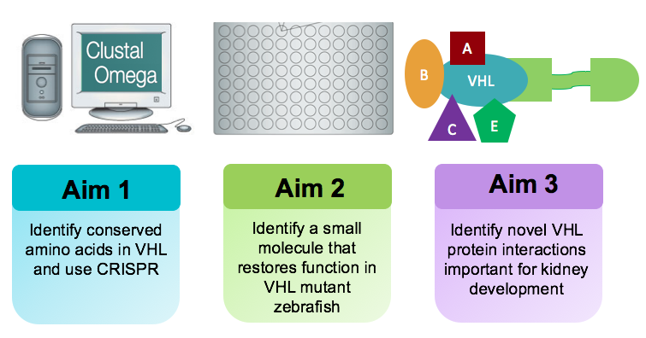
Questions?
VHL beta domain
VHL box domain

